Slide 1
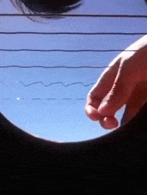
Daily Review
CFU 1
In the context of sound, define the word “medium” and give an example.
Sound is caused by the vibration of particles moving in a wavelike motion.
  This wave comes from a sound source.
  Sound waves require a medium to travel.
On your whiteboard, state the sound source in the picture below, and describe how it produces a sound wave.
CFU 2
True or false: Sound can travel through space? Explain your answer.
Vocabulary
Sound Source: the point from which a sound wave is emitted. Medium: a substance through which a wave travels.

Slide 2
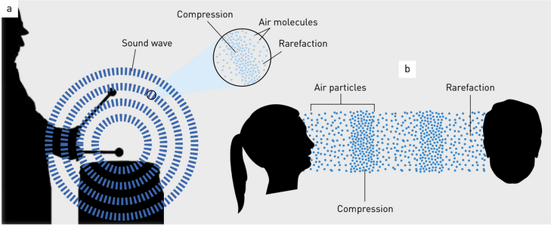
Daily Review
CFU 1
Describe the motion of a particle that is effected by a sound wave.
In a longitudinal wave, particles in the medium move parallel to the transmission of the wave
Compression: the part of a longitudinal wave where particles are forced together.
Rarefaction: the part of a longitudinal wave where particles are spread apart.
CFU 2
Identify the sound source in the image below.
Vocabulary
Parallel: extending in the same direction.

Slide 3

Daily Review
CFU 1
What is the medium that the sound is travelling though?
The image below shows the soundwave produced when someone calls your name.
Does the arrow of the sound wave show compression or rarefaction?
Identify compression and rarefaction in a sound wave
Identify the medium through which the sound is travelling. Are the particles within a medium bunched together? compression Are the particles within the medium spread out? rarefaction
CFU 2
Are the particles bunched together or spread out?
The sound wave is travelling through _____. The particles _____, therefore the arrow shows an area of _______.
Reminders:
Medium: a substance through which a wave travels.

Slide 4
Properties of Waves
Year 9 Physics

Slide 5
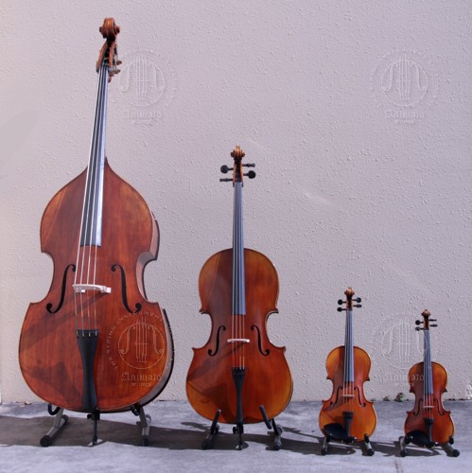
Learning Objectives
CFU
Which 3 properties of waves will we be learning about today?
Describe amplitude, wavelength and frequency of a wave.
Describe the effects that changing these properties have on a sound wave.
Activate Prior Knowledge
Instruments come in a variety of sizes and shapes.
Think-pair-share
  Which of these do you think would make the highest pitch sound?
  How would you make the volume of each instrument louder?

Slide 6
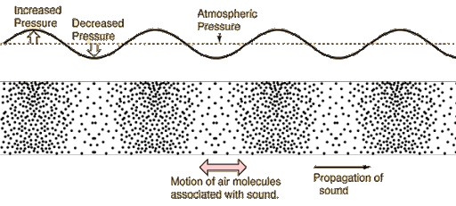
Concept Development
CFU 1
How are compressions represented? Why are they shown this way?
Sound waves are a type of longitudinal wave.
These waves are often represented using dots or lines to show the compressions and rarefactions.
They can also be represented using a single wavy line.
Compressions are shown as peaks (areas of high density and increased pressure)
Rarefactions are shown as troughs (areas of low density and low pressure)
The dashed line shows the resting position of the particles.
CFU 2
What are the factors that effect sound?

Slide 7
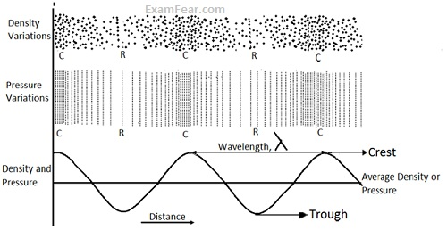
Concept Development
CFU 1
How many factors affect the sounds we hear?
When we hear a sound wave, the way that it sounds to us is determined by 3 factors of the sound wave.
These are:
  Frequency of the wave
  Wave length of the wave
  Amplitude of the wave
Vocabulary
Note: waves can be represented in a number of forms.

Slide 8
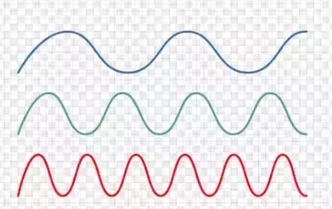
Concept Development
CFU 1
What is the frequency of a wave?
Frequency
The number of waves cycles that pass a point every second.
Frequency affects the pitch of a sound.
  High frequency = high pitch
  Low frequency = low pitch
We give frequency the symbol f and it is measured in Hertz (Hz).
CFU 2
What is the unit of measurement for frequency?
CFU 3
Think-pair-share Which of the 3 sound waves would have the lower pitch? Which would have the highest pitch? Explain why.

Slide 9
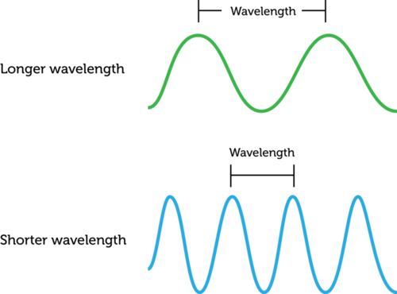
Concept Development
CFU 1
How do we measure the wavelength?
Wavelength
The distance between two crests or two troughs of a wave.
  Crests correspond to areas of compression in a sound wave.
  Troughs correspond to areas of rarefaction in a sound wave.
We give wavelength the symbol λ (the Greek letter “Lambda”) and the unit of measurement is meters (m).
CFU 2
Which of these waves would be the lowest pitch?
CFU 2
Think-pair-share: How is wavelength related to the frequency (pitch) of a sound wave?
Vocabulary
Crest - The highest point of a wave. Trough – The lowest point of a wave

Slide 10
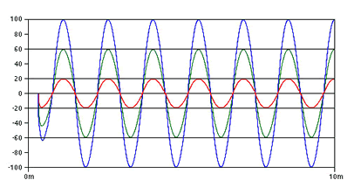
Concept Development
CFU 1
What does the amplitude of a sound wave tell us?
Amplitude
The distance a particle moves from its resting position.
  The distance between the crest and the midline of a wave.
The amplitude of a sound, affects its loudness.
  High amplitude = louder
  Low amplitude = softer
CFU 2
How do we measure the amplitude of a wave?
CFU 3
Think-pair-share: Which of the 3 waves would be the loudest? How do you know?
Vocabulary
Loudness – how loud of soft a sound wave is to its listener.

Slide 11
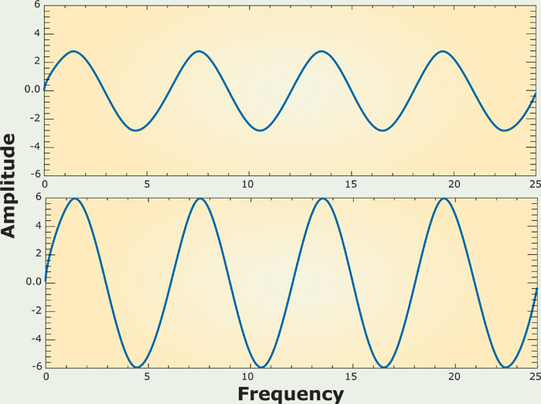
Skill Development / Guided Practice
Comparing Sound Waves
Compare the frequency/amplitude. Is one higher/lower? Are they equal? How does this affect the pitch/volume?
Compare and contrast sound waves A and B with reference to their pitch.
Sound wave A has ______ frequency than sound wave B, therefore it will have ______ pitch.
A
B

Slide 12
Skill Development / Guided Practice
Comparing Sound Waves
Compare the frequency/amplitude. Is one higher/lower? Are they equal? How does this affect the pitch/volume?
Compare and contrast sound waves A and B with reference to their volume.
Sound wave A has ______ amplitude than sound wave B, therefore it will be ______ volume.
A
B

Slide 13
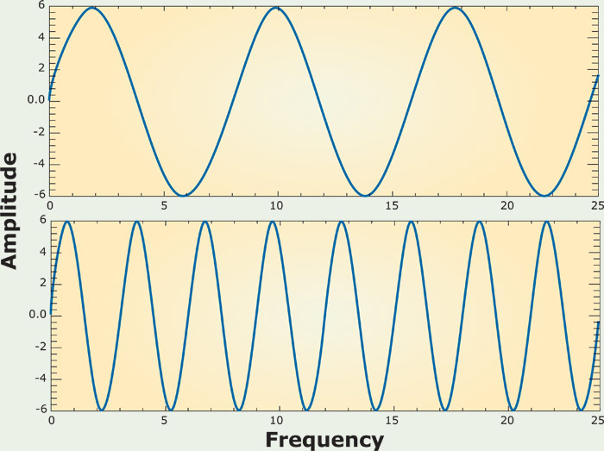
Skill Development / Guided Practice
Comparing Sound Waves
Compare the frequency/amplitude. Is one higher/lower? Are they equal? How does this affect the pitch/volume?
Compare and contrast sound waves A and B with reference to their volume.
Sound wave A has ______ amplitude than sound wave B, therefore it will be ______ volume.
A
B

Slide 14
Skill Development / Guided Practice
Comparing Sound Waves
Compare the frequency/amplitude. Is one higher/lower? Are they equal? How does this affect the pitch/volume?
Compare and contrast sound waves A and B with reference to their pitch.
Sound wave A has ______ frequency than sound wave B, therefore it will have ______ pitch.
A
CFU 1
Challenge - If the measurement on the x-axis was in meters, what is the wavelength of each wave?
B

Slide 15
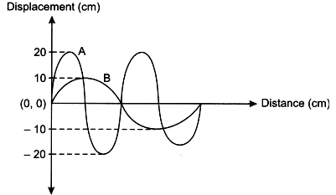
Skill Development / Guided Practice
Comparing Sound Waves
Compare the frequency/amplitude. Is one higher/lower? Are they equal? How does this affect the pitch/volume?
Compare and contrast sound waves A and B with reference to their pitch and volume.

Slide 16
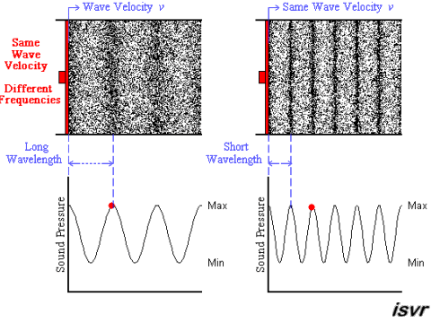
Skill Development / Guided Practice
Comparing Sound Waves
Compare the frequency/amplitude. Is one higher/lower? Are they equal? How does this affect the pitch/volume?
Compare and contrast sound waves A and B with reference to their pitch and volume.
A
B

Slide 17
Relevance
You hear noises every day all around you, understanding what makes them loud or soft, high pitch of low pitch, will bring more relevance to those sounds.
Some of you may enjoy music and hope to work in that field, this basic knowledge will help give you some insight into sound.
Amplitude, frequency and wavelength are all applicable to a variety of different types of waves (e.g. light) that we will study later.

Slide 18
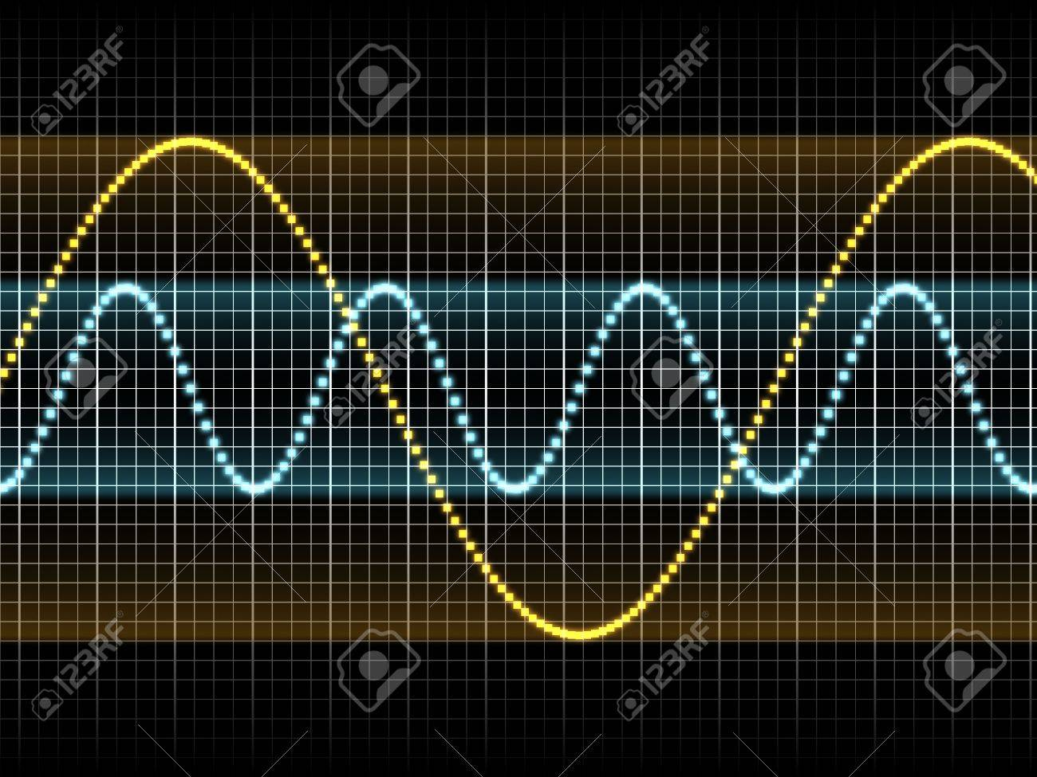
Skill Closure
Comparing Sound Waves
Compare the frequency/amplitude. Is one higher/lower? Are they equal? How does this affect the pitch/volume?
How is the wavelength of a wave measured? What units are used?
Skill Closure
The yellow sound wave is Mr Byrne’s voice, and the blue sound wave is Miss Gulberti’s voice.
Who’s voice is louder? Explain your answer.
Who’s voice is higher pitch? Explain your answer.

Slide 19
Independent Practice
Complete the worksheet on sound waves.
Finish the worksheet that you started last lesson.

